Slide 1
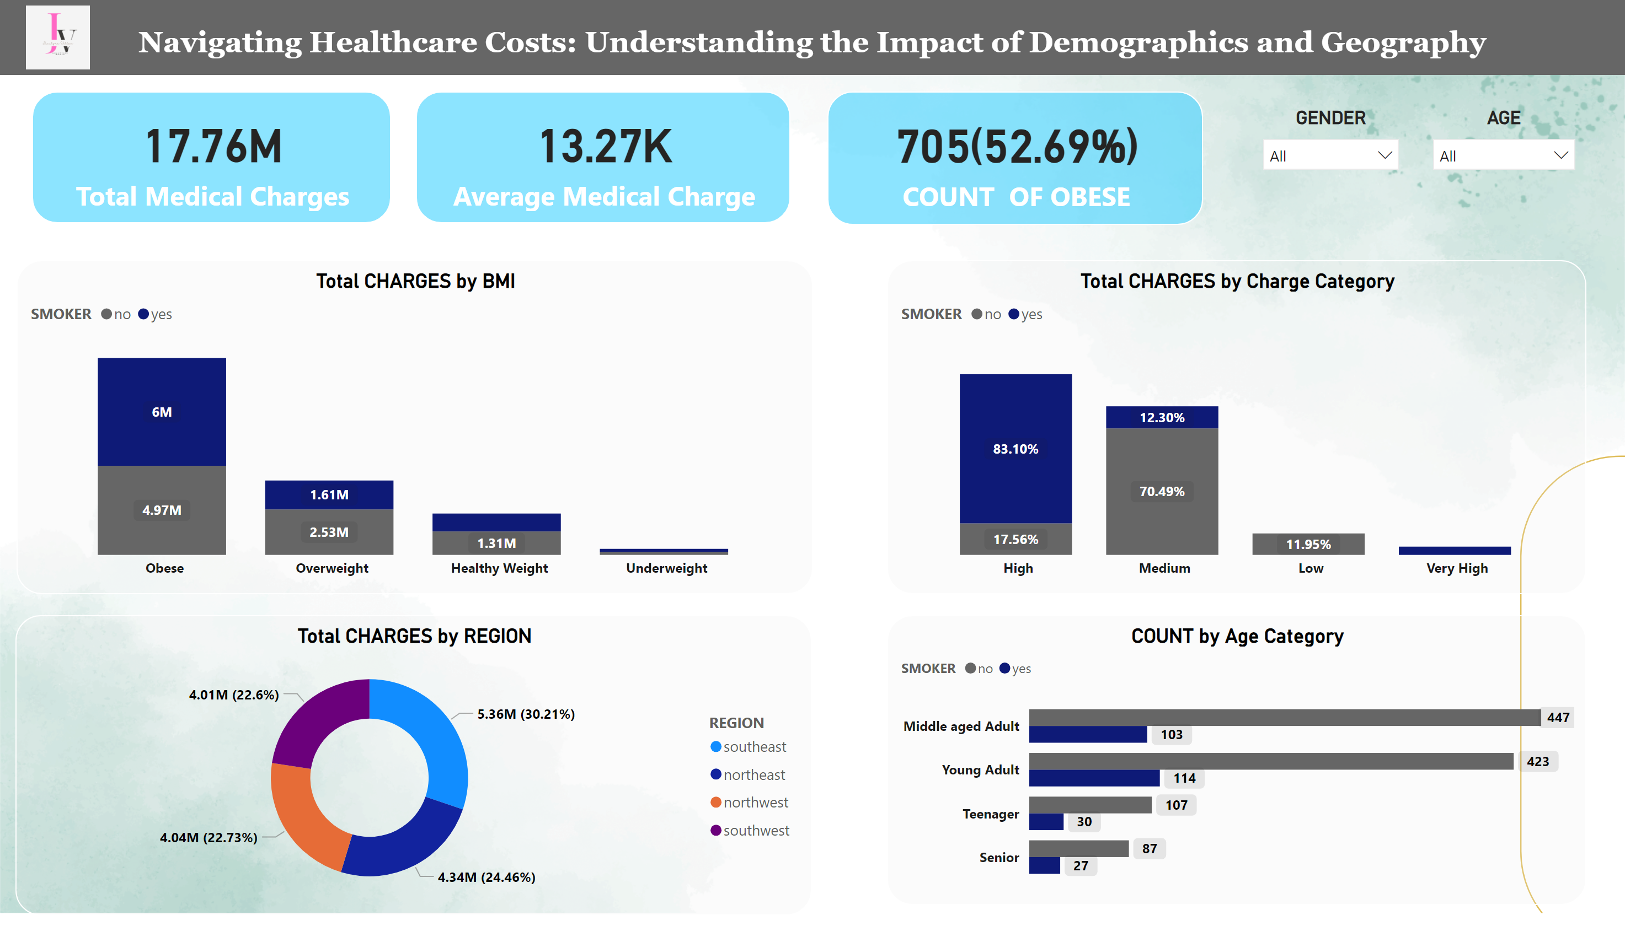
Page 1
Notes:
TOTAL CHARGES
No alt text provided
card
No alt text provided
card
No alt text provided
Total CHARGES by BMI
No alt text provided
Total CHARGES by Charge Category
No alt text provided
Total CHARGES by REGION
No alt text provided
AGE
No alt text provided
COUNT by Age Category
No alt text provided
GENDER
No alt text provided
textbox
No alt text provided
image
No alt text provided

